Slide 1
Direct lending fund structures before and after TCJA
Regression Analysis and Plots

Slide 2
Outline
Consider how change in structures for direct lending funds (estimated AUM in 2025 is $1.8 trillion) after TCJA may be shown in IRS data
Structures (pre- and post-TCJA)
IRS data
Hypothesis
Findings
Other interesting plots

Slide 3
1. Pre TCJA structure: season-and-sell
ECI-sensitive LPs
UBTI-sensitive LPs
U.S. taxable LPs
GP
Manager
Offshore Feeder (Cayman)
Independent Directors
Interest Income
Onshore Fund (DE)
Offshore Fund (Cayman or DE)
Seasoned loans
Debt
Interest Income
Loans with borrowers
Loans with borrowers

Slide 4
2. Post-TCJA structure: leveraged blocker
Key motivation for the change in structures was the corporate tax rate cut from 35% to 21%. Using a “blocker” to convert business income into investment income was more worthwhile because of the decrease in the tax cost of using an entity subject to corporate tax.
U.S. taxable LPs
ECI-sensitive LPs
UBTI-sensitive LPs
GP
Parallel (Cayman or US)
Main
Equity (High-vote)
Debt
Equity (Low-vote)
Interest Income
U.S. Leveraged Blocker
Interest Income
Origination SPV
Interest Income
Loans with borrowers

Slide 5
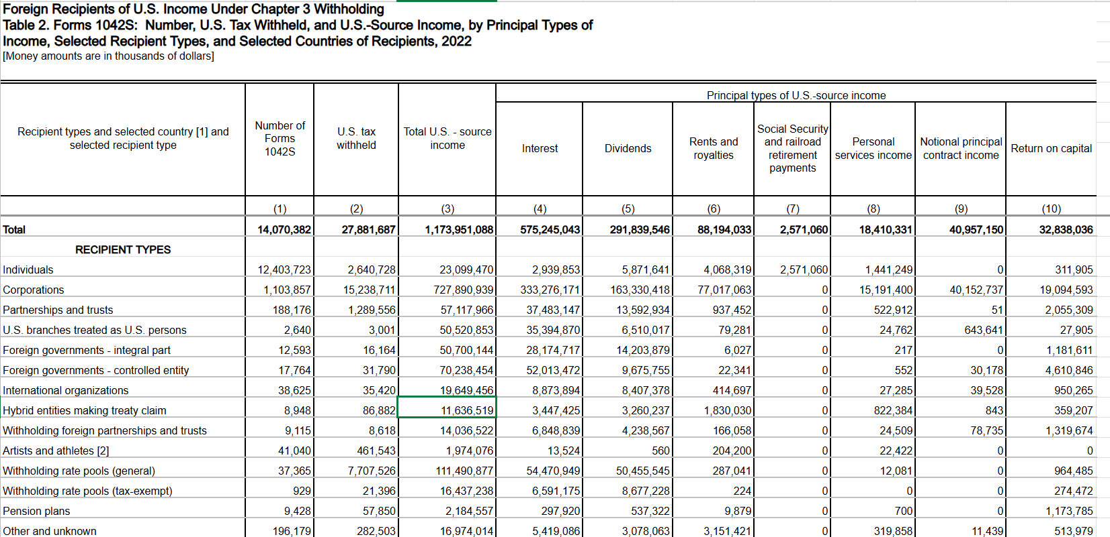
2. IRS Data
IRS publishes data on U.S. source income to foreign recipients.
Entity data – rows below classify income based on recipient type (individual, corporation, partnership, foreign government, etc.)

Slide 6
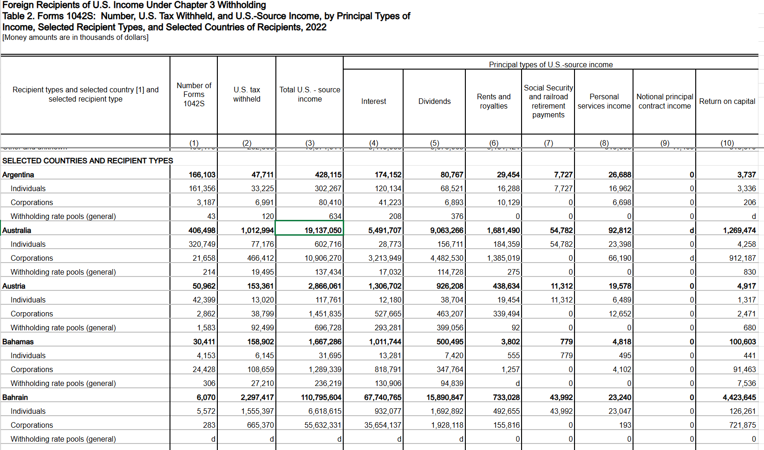
2. IRS Data
Country data – latter rows are classified based on country

Slide 7
3. Hypotheses
Interest income
Pre-TCJA, interest income was paid to Cayman entity treated as a corporation for U.S. tax purposes. Post-TCJA, interest income would be paid to a U.S. corporation.
Hypothesis: Interest income paid to foreign corporations would go down after TCJA.
Hypothesis: Interest income paid to Cayman corporations would go down after TCJA.
Forms 1042-S
Pre-TCJA, Forms 1042-S would be filed for each borrower paying interest through the fund to the Cayman corporate feeder. Post-TCJA, Forms 1042-S would be filed by U.S. leveraged blocker to each investor in the Cayman partnership feeder.
Hypothesis: If loan size is smaller than investor commitment size, that is, if number of borrowers are more than number of investors, number of forms 1042-S to Cayman entities would decrease after TJCA.

Slide 8
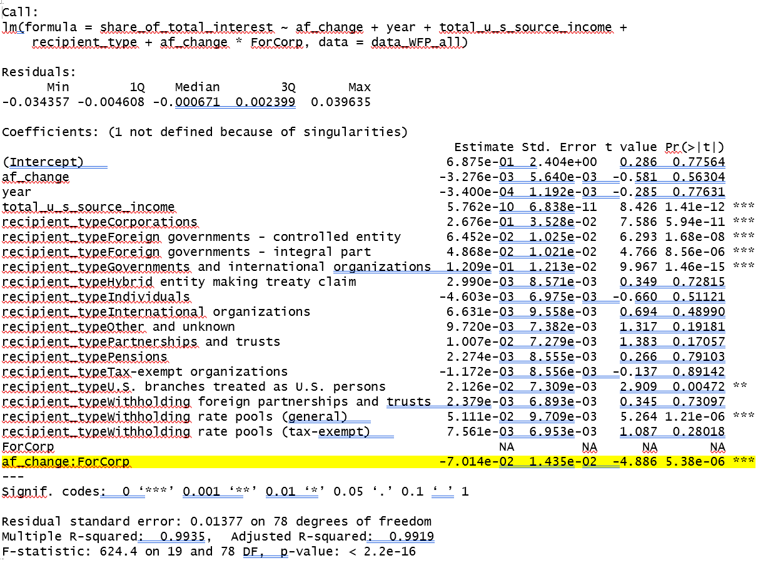
4. Interest Income Results
Using entity data, share of interest paid to foreign corporations decreased dramatically after TCJA, decreased by seven times with statistical significance.

Slide 9
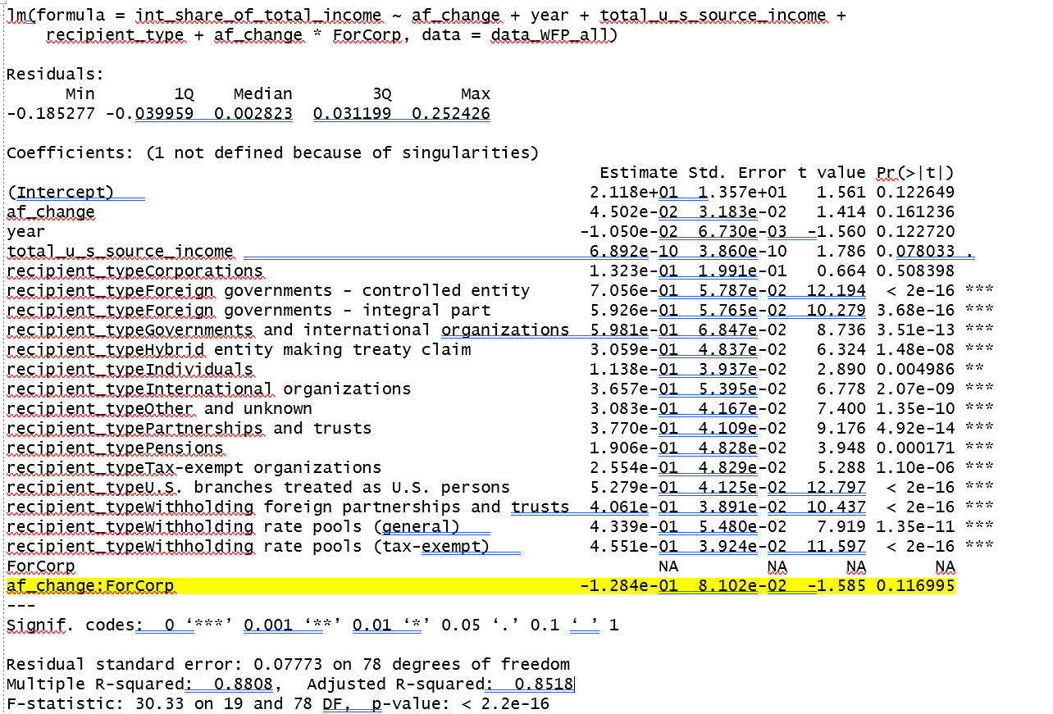
4. Interest Income Results
However, statistical significance disappeared when the control changed from “total U.S. source income” to “log (total U.S. source income)”

Slide 10
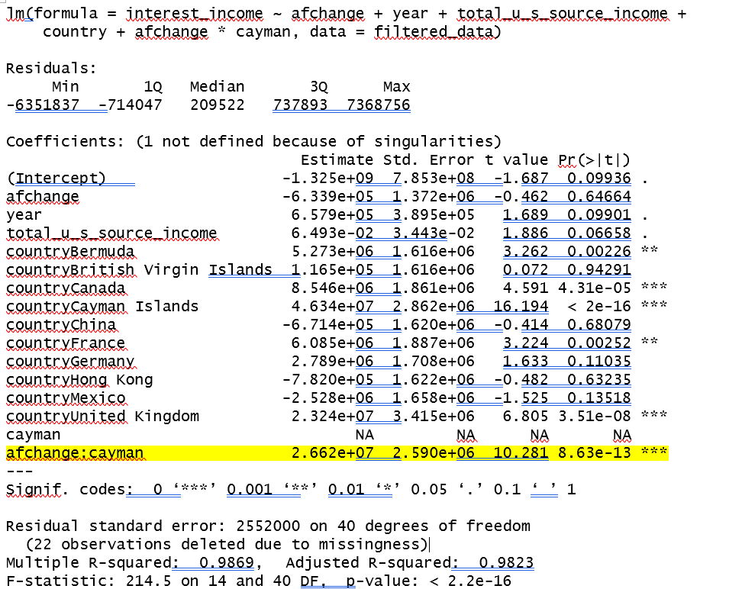
4. Interest Income Results
Using country data, interest income to Cayman entities increased after TCJA with statistical significance. However
Entities may include both corporations and partnerships, which would not say anything about the hypothesis that Cayman corporations would receive lesser amounts of interest income

Slide 11
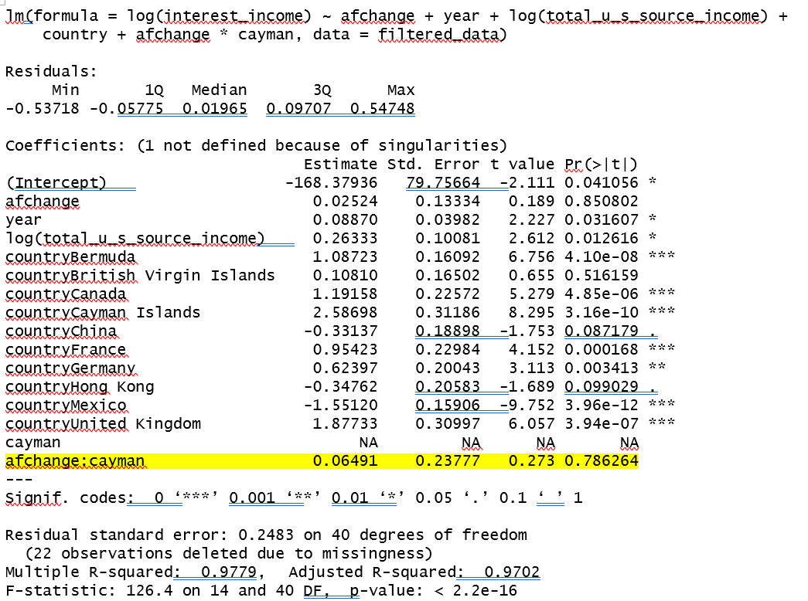
4. Interest Income Results
Using country data, statistical significance disappeared when the regression was run with log interest instead.

Slide 12
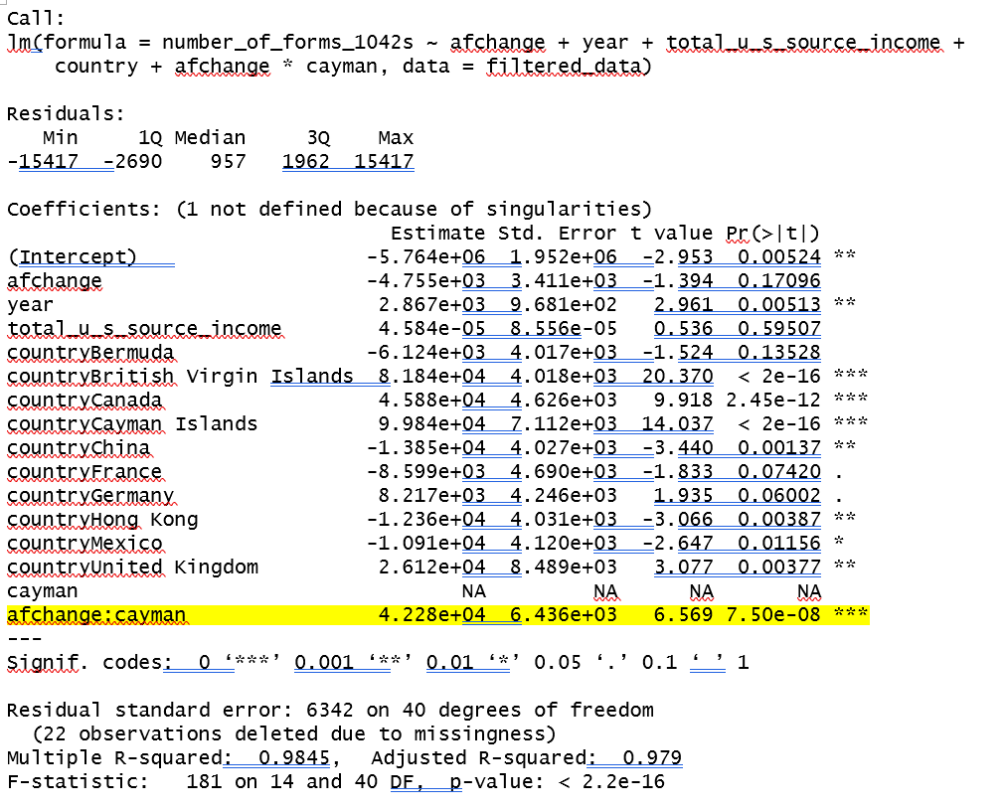
4. Forms 1042-S Results
Using country data, number of forms to Cayman entities increased but statistical significance went away when the regression was run with log number of forms instead. Rationale for poor results: Unclear whether in the post-TCJA structure, forms would be reported as issued to a Cayman partnership, or rather to the partners of the Cayman partnership. If the former, the number of forms to Cayman entities would not change before and after TCJA. In addition, data is not limited to type of industry or size of investment fund, which would impact number of borrowers and number (and size) of investors. My hypothesis would only be true for very large investment funds.

Slide 13
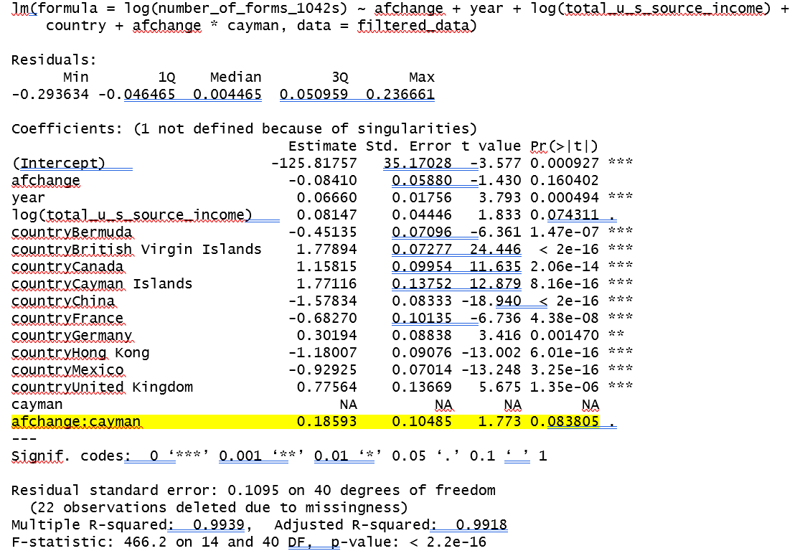
4. Forms 1042-S Results

Slide 14
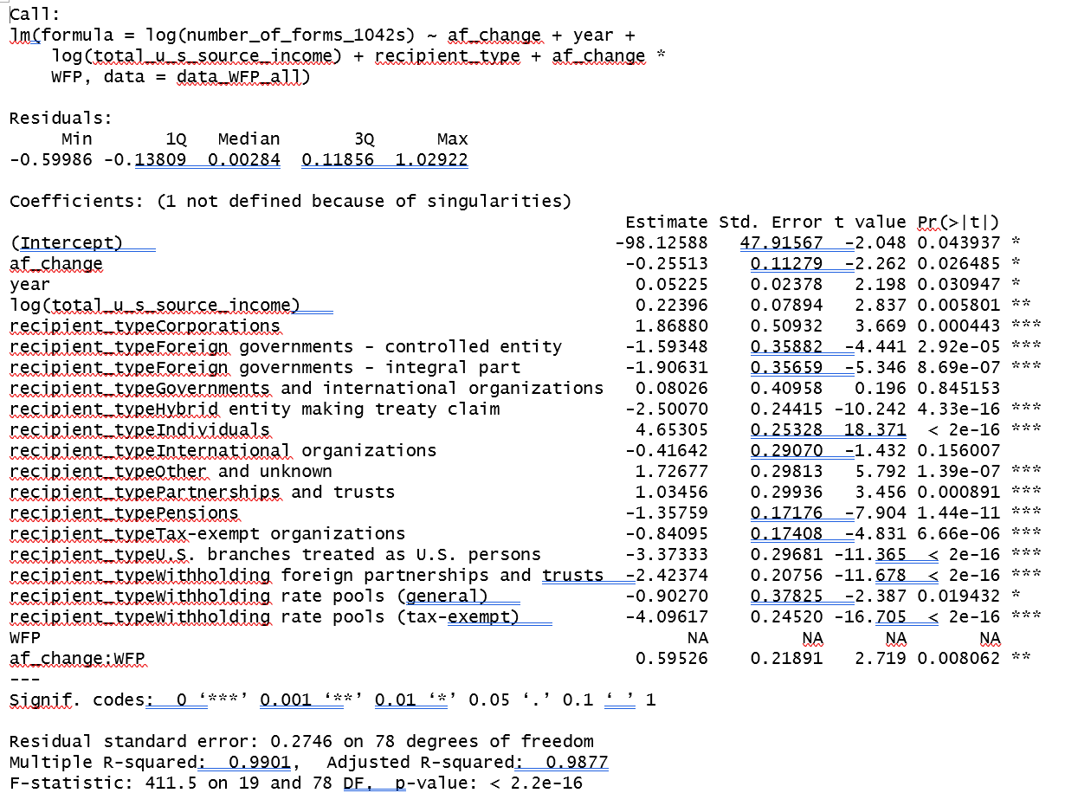
4. Bonus result – forms 1042S documenting payments to withholding foreign partnerships increased after TCJA, with statistical significance – what does this say about investment fund size (generally, larger funds are WFP)

Slide 15
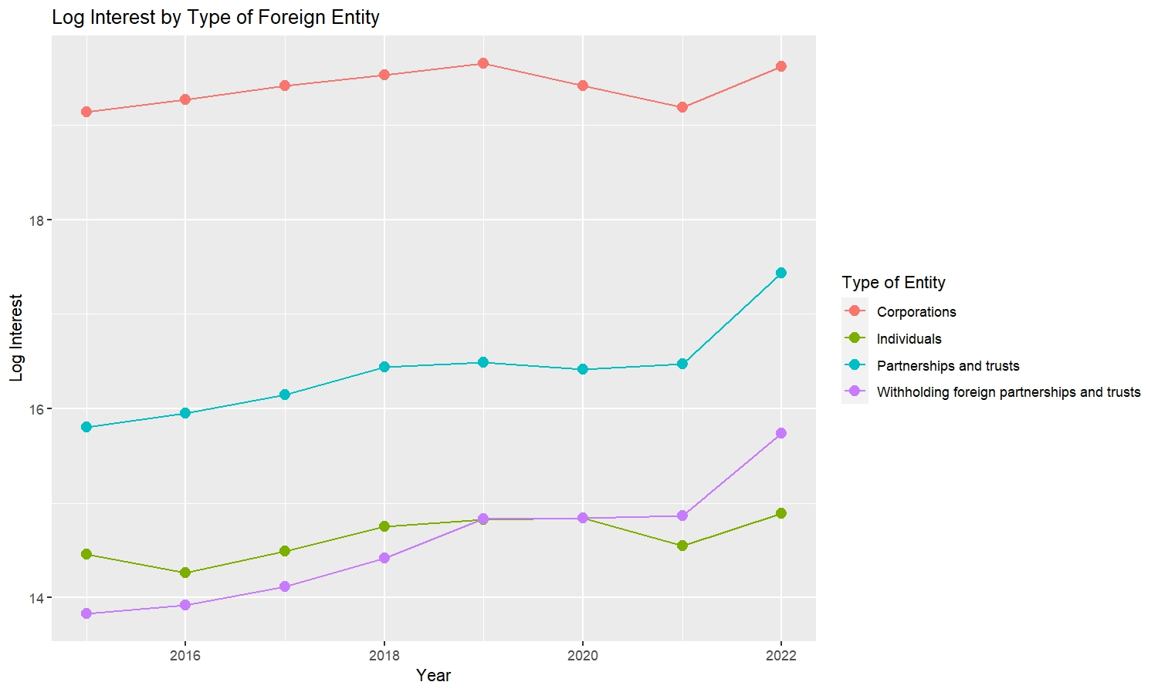
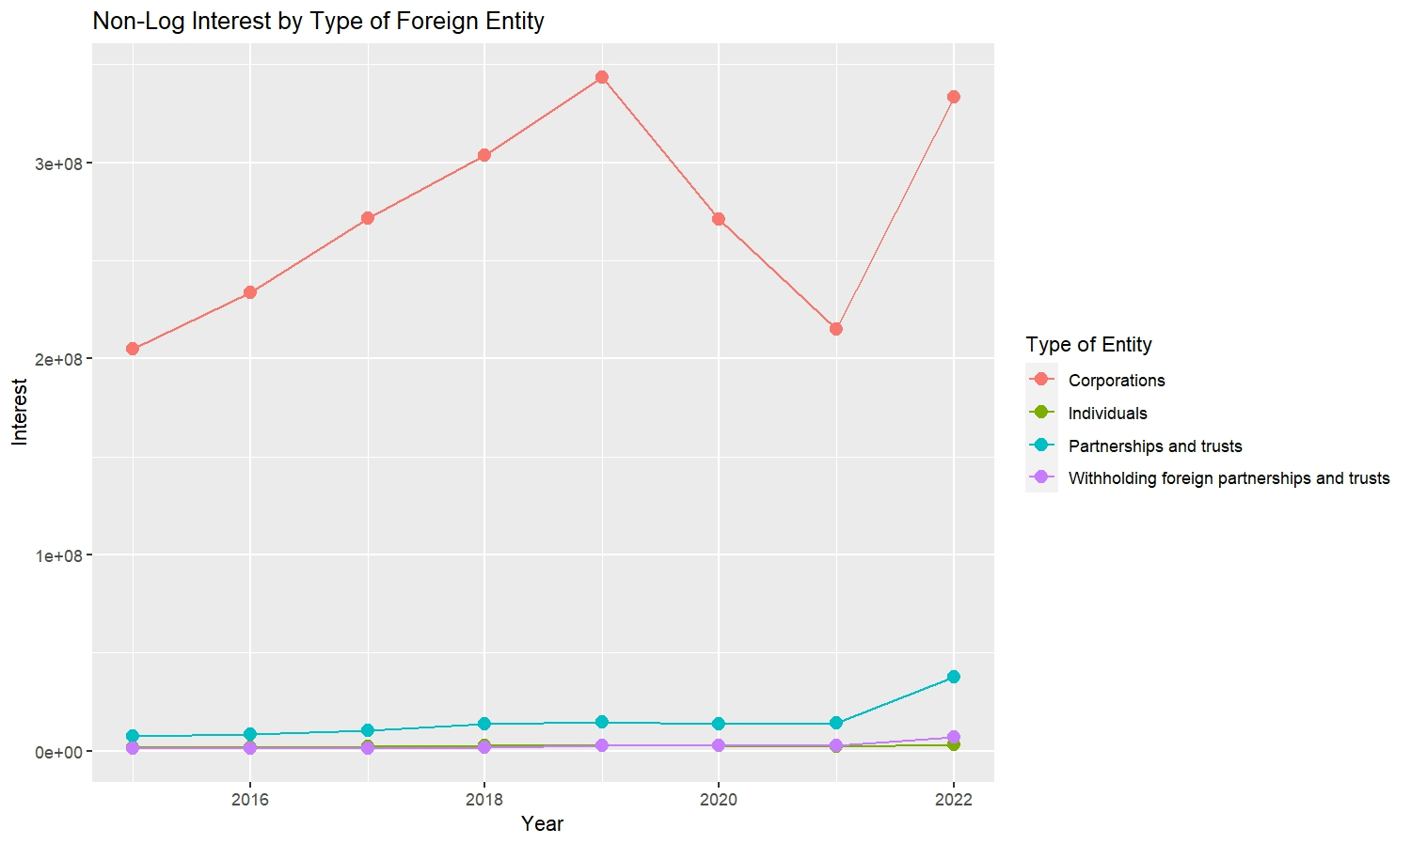
5. Plots: Foreign corporations’ share of interest income dropped significantly after 2017

Slide 16
5. Plots: Foreign corporations receive most of the interest income

Slide 17
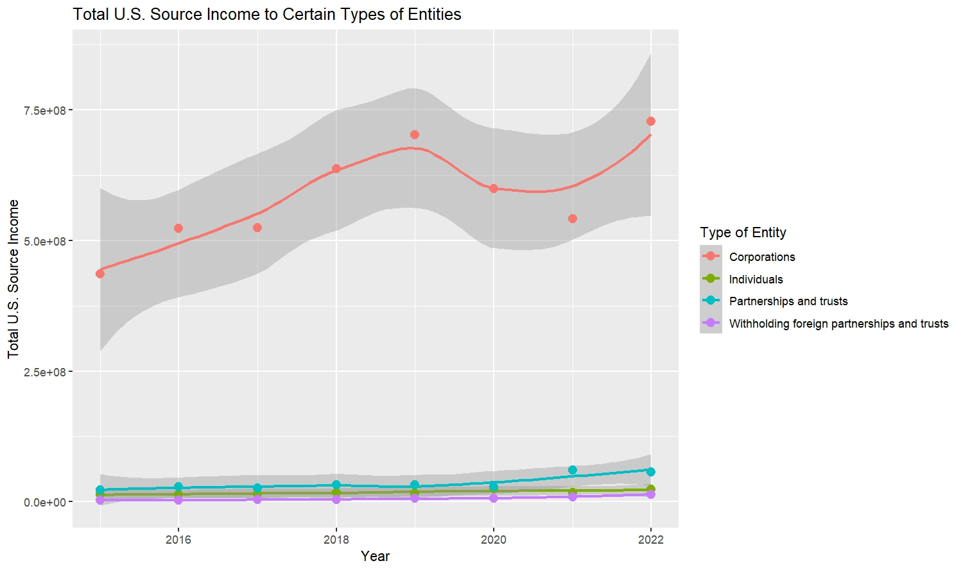
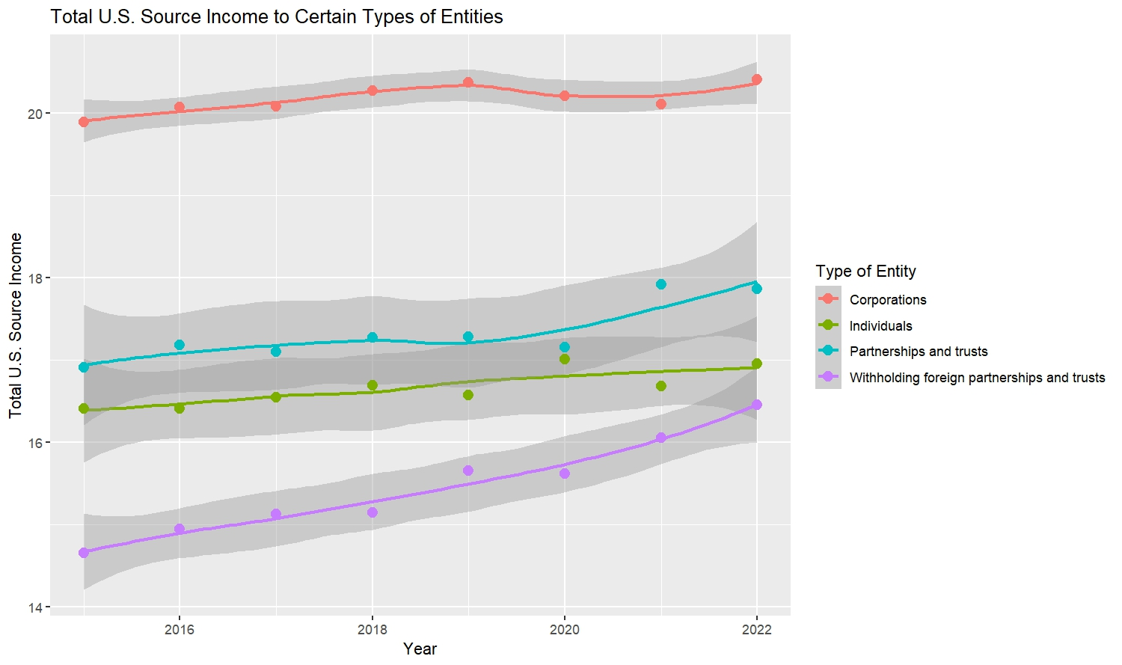
5. Plots: Foreign corporations also receive most of the U.S. source income, but withholding foreign partnerships’ share is increasing

Slide 18
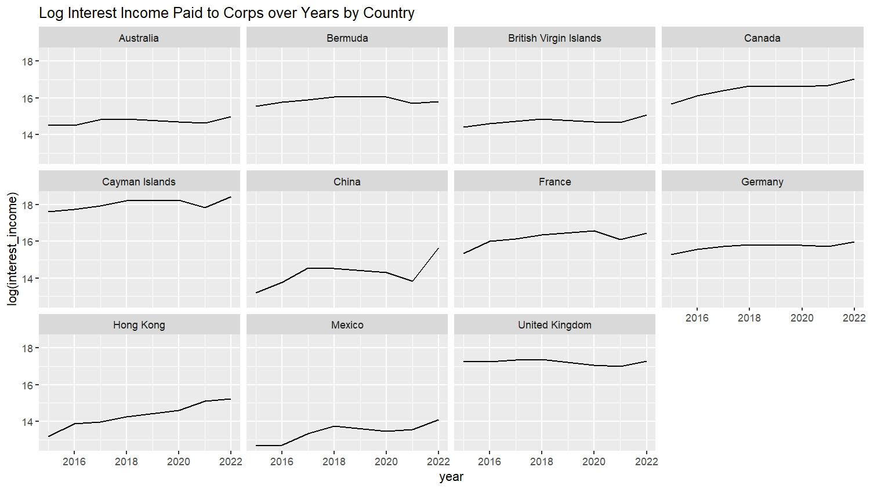
5. Plots: Cayman receives most of the U.S. source interest payments

Slide 19
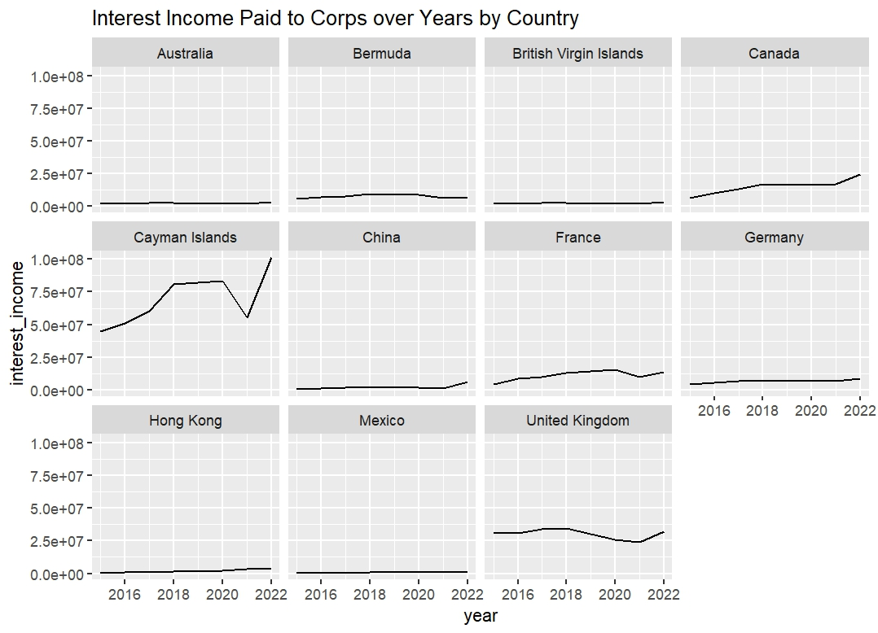
5. Plots: Cayman receives most of the U.S. source interest payments

Slide 20
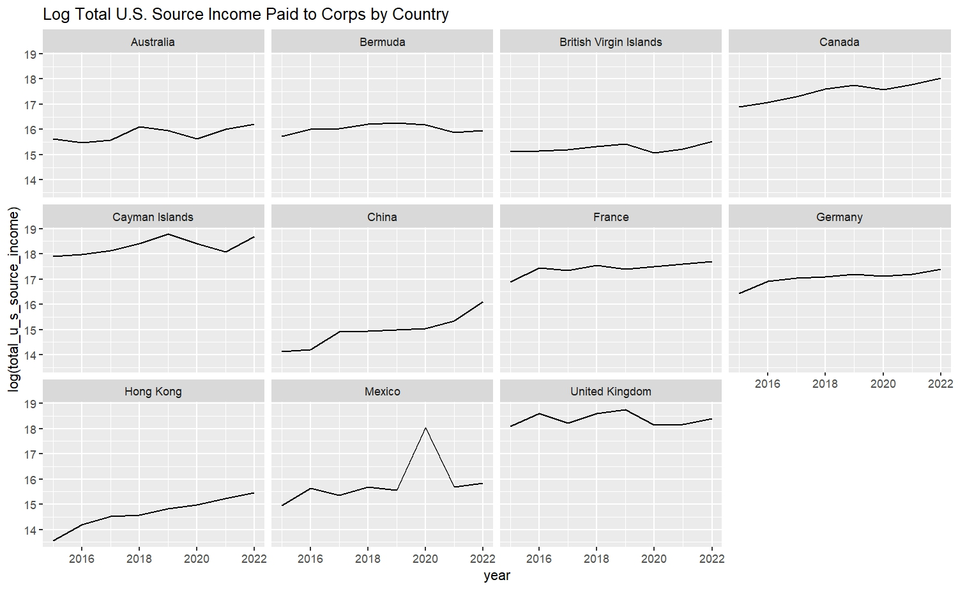
5. Plots: Cayman receives the largest share of total U.S. payments

Slide 21
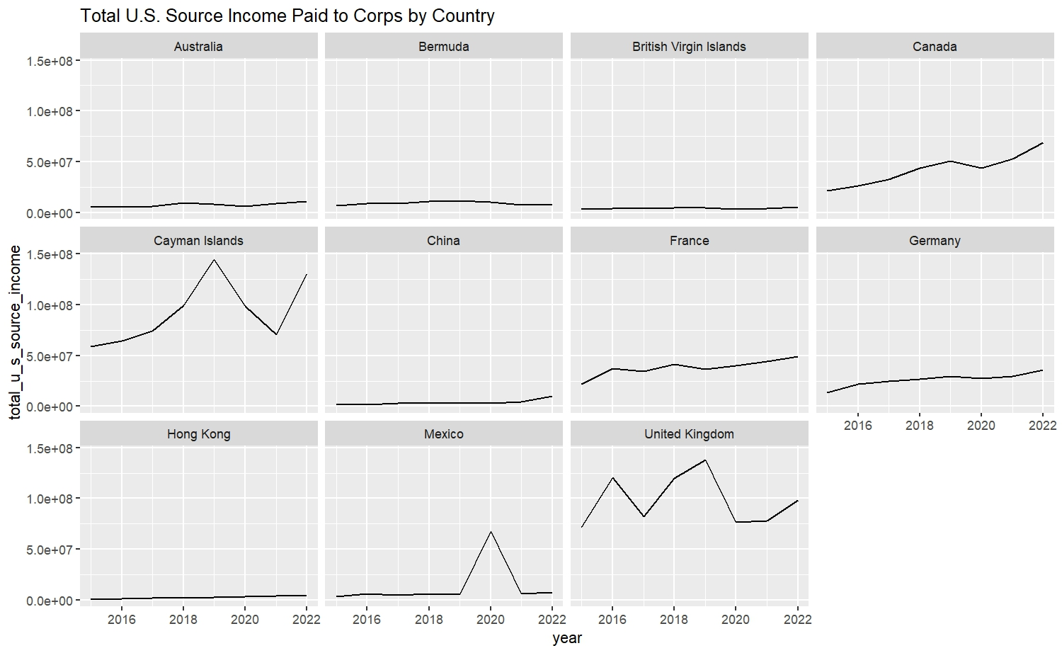
5. Plots: Cayman receives the largest share of total U.S. payments
Notes:
To do: fix IRS categories, fix share of total income

